Slide 1

Simulation of Mass Vaccination Programs: Centralized versus Mobile Vaccination
Mohammed Z. Guniem
Prof. Reggie Davidrajuh

Slide 2
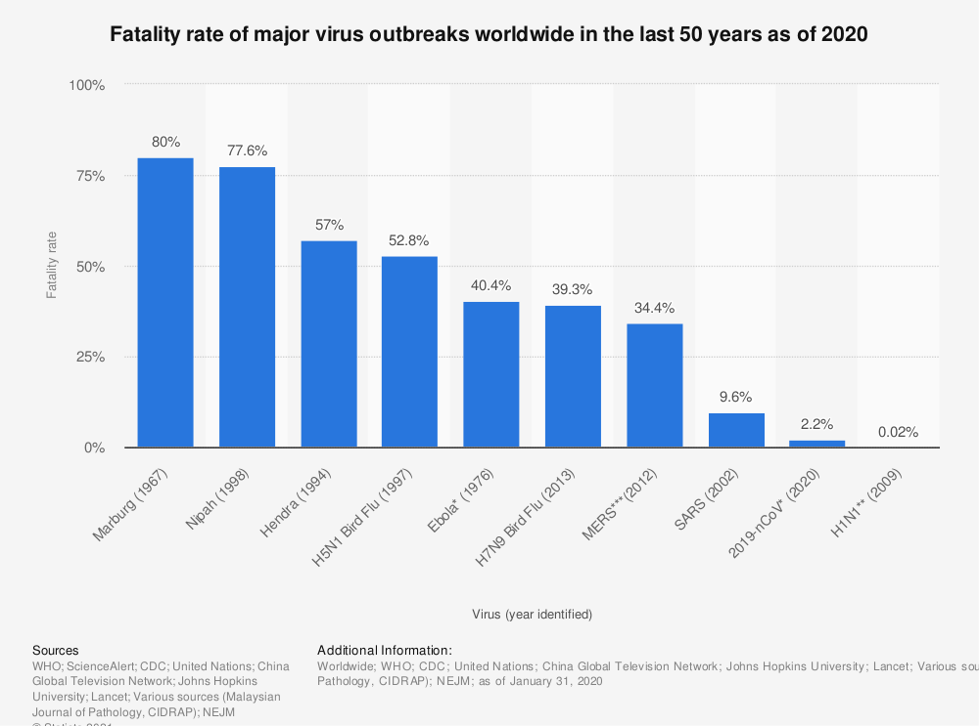
Decreasing fatality rate of major virus outbreaks
The fatality rate of some major virus outbreaks since 1976, [1].

Slide 3
Motivation – Part I
In centralized vaccination:
  Residents have to visit a vaccination centre and stand in long lines.
  Higher risk to become infected while waiting for the vaccine.
  The elderly and people with special needs struggle in visiting the vaccination centre.
  More human and material resources go into establishing and maintaining the vaccination centres in different areas.
These disadvantages can lead to fewer people wanting to receive the vaccine
  Thus, less vaccination rate, and higher fatality rate

Slide 4
Motivation – Part II
Mobile Vaccination.
  Eliminates the need for vaccination centres as busses visit residents at their homes.
Some advantages of mobile vaccination are
  Reducing crowd gathering which helps prevent the spread of the virus.
  Higher vaccination rate, due to higher coverage area
  In general, fewer human and material resources are required.
However, mobile vaccination requires more coordination and management effort.
  What happens if one vaccination bus experiences some mechanical issues?
  Residents have to be at home when they are visited by the vaccination bus.

Slide 5
Goal
Compare between centralized and mobile vaccination in a controlled simulation environment in terms of:
    Human Resources.
    Material Resources.
    Time.
    Vaccination rate.

Slide 6
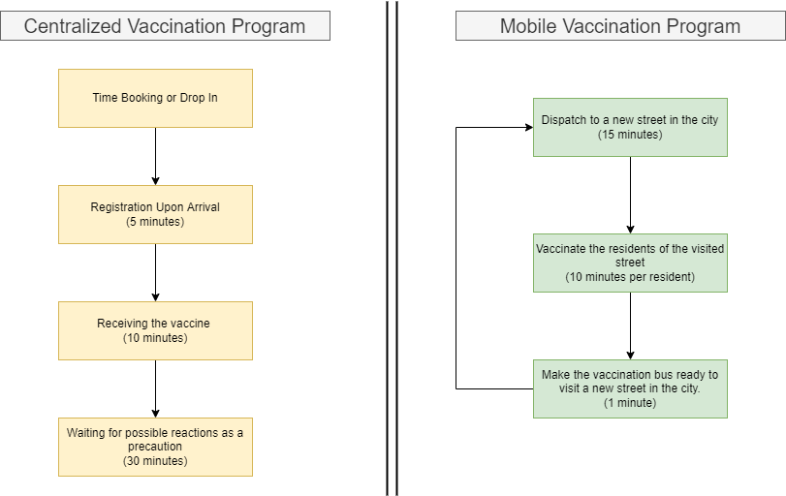
Centralized vs. Mobile Vaccination – Proposed Workflow

Slide 7
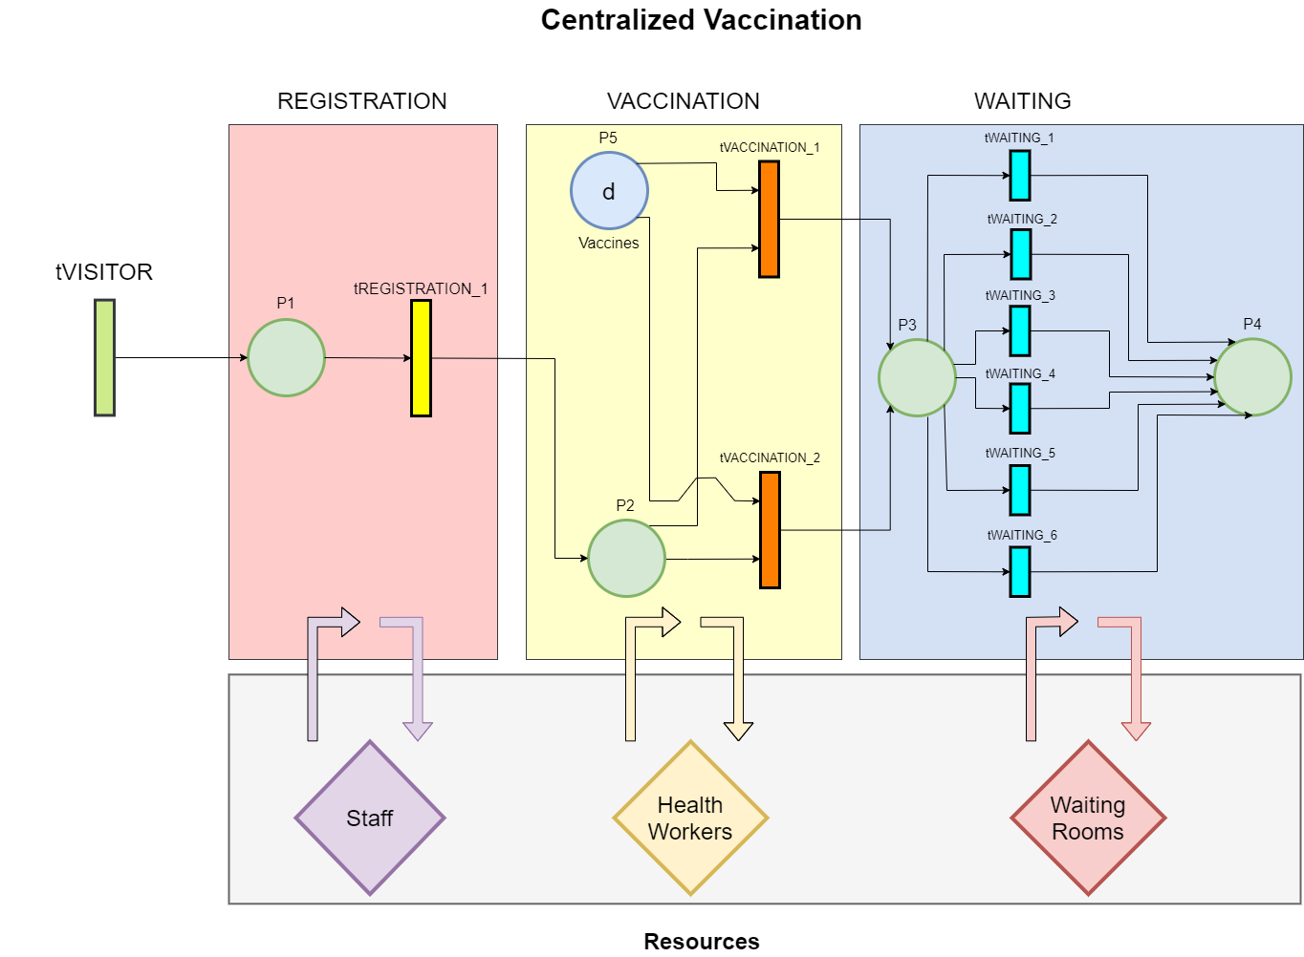
Centralized Vaccination – Simplified Petri Net
Tokens represent visitors/vaccine recipients.
Transitions represent the processes of:
  Registration
  Vaccination
  Waiting for side effects (Observation).
Staff, health workers, and waiting rooms are represented as resources.
Ideal Throughput in 30 minutes is 6 visitors:
  1 Staff register 6 visitors
  2 Health workers vaccinate 6 visitors.
  6 Waiting rooms can be used by 6 visitors.

Slide 8
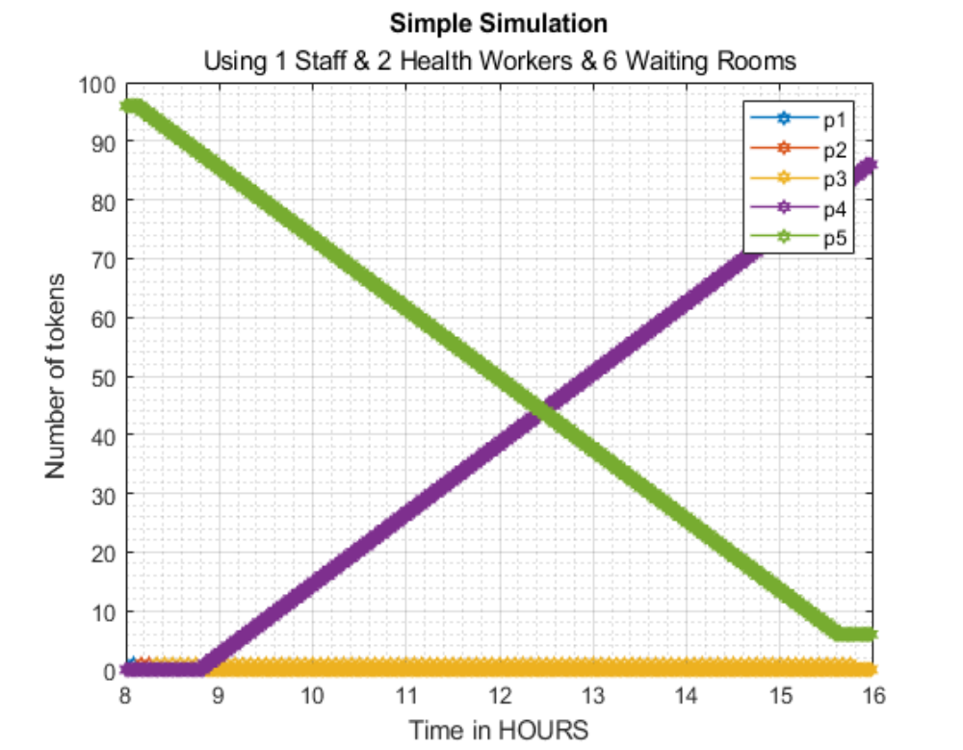
Centralized Vaccination – Implementation & Testing
Using GPenSIM in Matlab.
Minimal and optimal set of resources:
  1 Staff for Registration
  (Registers 1 person each 5 minutes)
  2 Health workers in Vaccination
  (Vaccinate 2 persons each 10 minutes)
  6 Waiting rooms.
  (Occupied by 6 persons each 30 minutes)
Running the simulation for 1 working day from 8 to 16.
Able to fully vaccinate around 85 persons. (by observing the number of tokens at place p4)

Slide 9
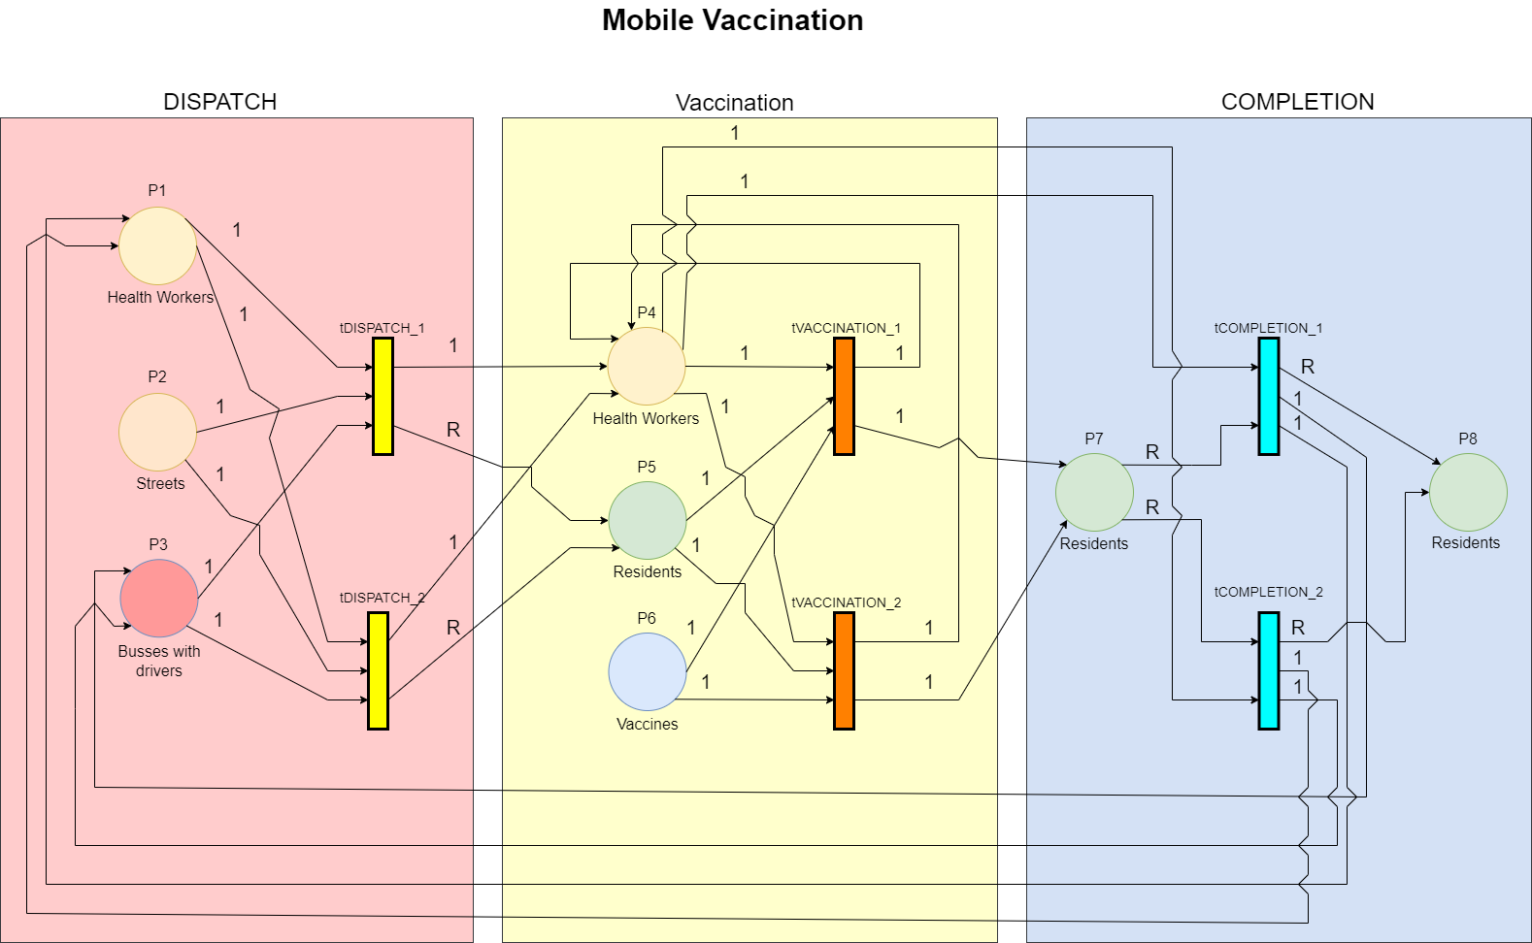
Mobile Vaccination – Simplified Petri Net
Tokens represents:
  Health workers (P1, P4)
  Streets (P2)
  Busses with their drivers (For simplicity) (P3)
  Residents or vaccine recipients (P5, P7, P8)
  Vaccine doses (P6)
Transitions represent the processes of:
  Dispatch
  Vaccination
  Turnaround or Completion.
Ideal Throughput depends on:
  The number of streets to visit
  The average number of residents per street (R).
  The available resources, i.e., health workers, busses.

Slide 10
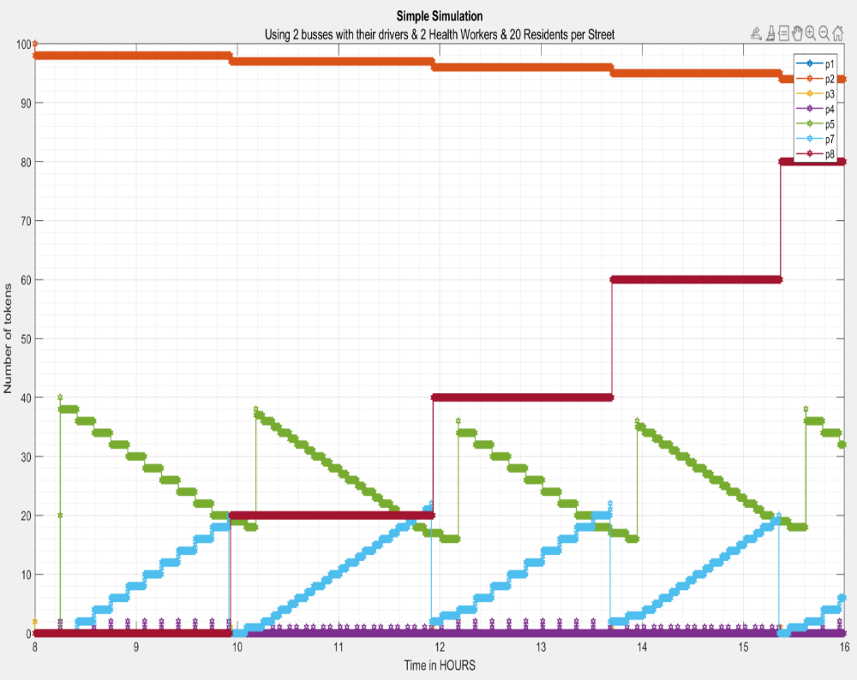
Mobile Vaccination – Implementation & Testing
Using GPenSIM in Matlab.
Minimal and optimal set of resources:
  2 busses with their drivers
  2 Health workers.
Assuming each visited street houses 20 residents on average.
Running the simulation for 1 working day from 8 to 16.
Also, able to fully vaccinate around 85 persons. (by observing the number of tokens at place p7 and p8)

Slide 11
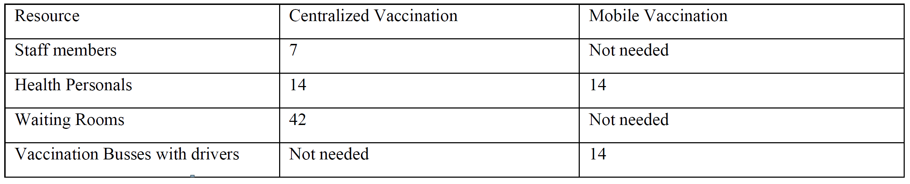
Centralized vs. Mobile Vaccination – Experimental Setup & Study Case
Using the municipality of Stavanger, Norway as a study case, due to
  It has a small to medium-sized population (lower running time of simulation)
  The spread of residents across different geographic areas such as residential areas, mountains or hills, or farmland. (Significant factor under mobile vaccination)
  Available data about residents and the number of streets in the municipality allow us to estimate the average number of residents per street to around 73 residents per street.
Increasing the resources according to be able to vaccinate more people on each vaccination program.
  Keeping a logical quantity to what a municipality like Stavanger can provide.
  Trying to maintain a fair balance of available resources between centralized and mobile vaccination.
Running the simulation for 1 working day from 8 to 16.

Slide 12
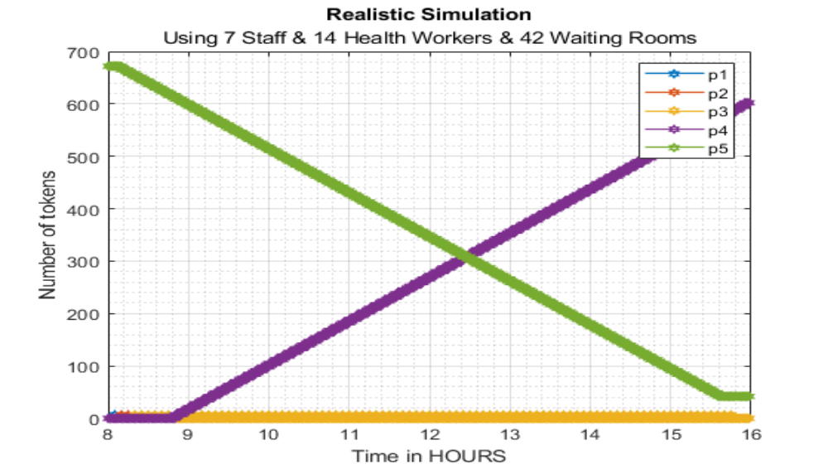
Centralized Vaccination – Final Experimental Simulation
Figure 7, Simulation results of centralized vaccination using GPenSIM, and having a realistic set of available resources, consisting of 7 staff members, 14 health personnel, and 42 waiting rooms.

Slide 13
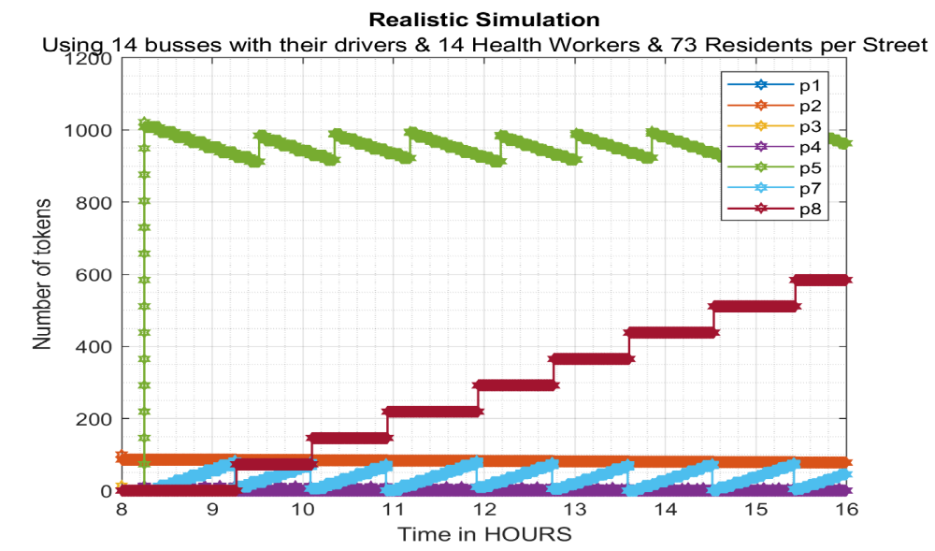
Mobile Vaccination – Final Experimental Simulation
Figure 8, Simulation results of mobile vaccination using GPenSIM, and having a realistic set of available resources, consisting of 14 health personnel, accompanied with 14 vaccination busses each having a dedicated bus driver.

Slide 14
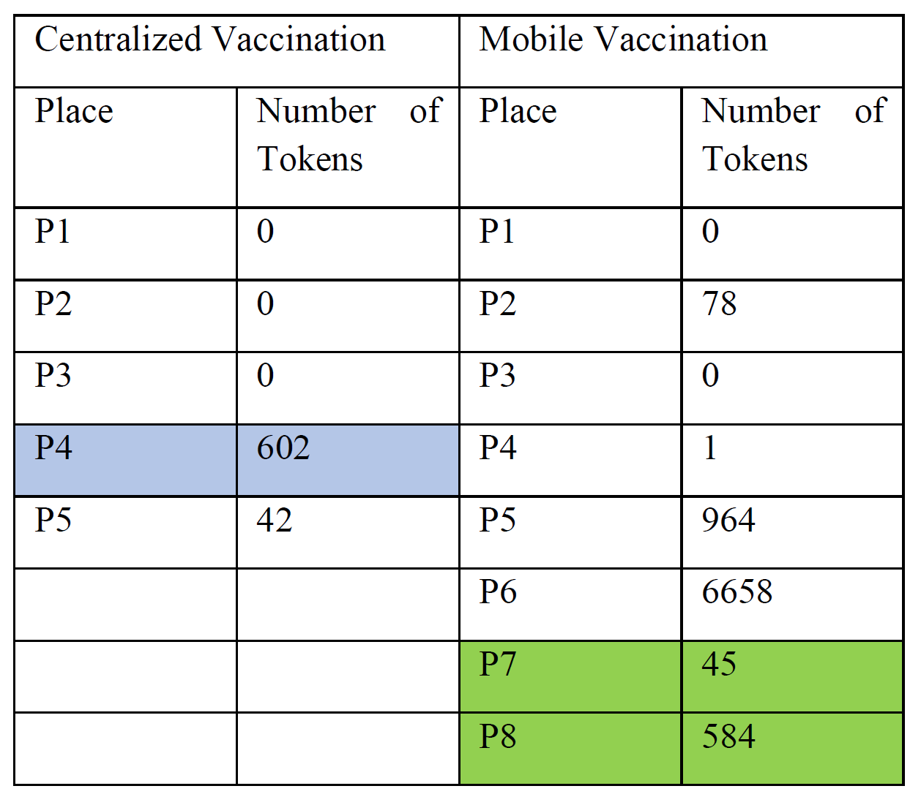
Centralized vs. Mobile Vaccination – Experimental Results
Mobile vaccination is able to fully vaccinate 27 more people than centralized vaccination in one working day.
Mobile vaccination uses fewer busses, than waiting rooms in centralized vaccination.
Mobile vaccination uses more bus drivers, then centralized vaccination uses of registration staff.
Both uses the same number of health workers.

Slide 15
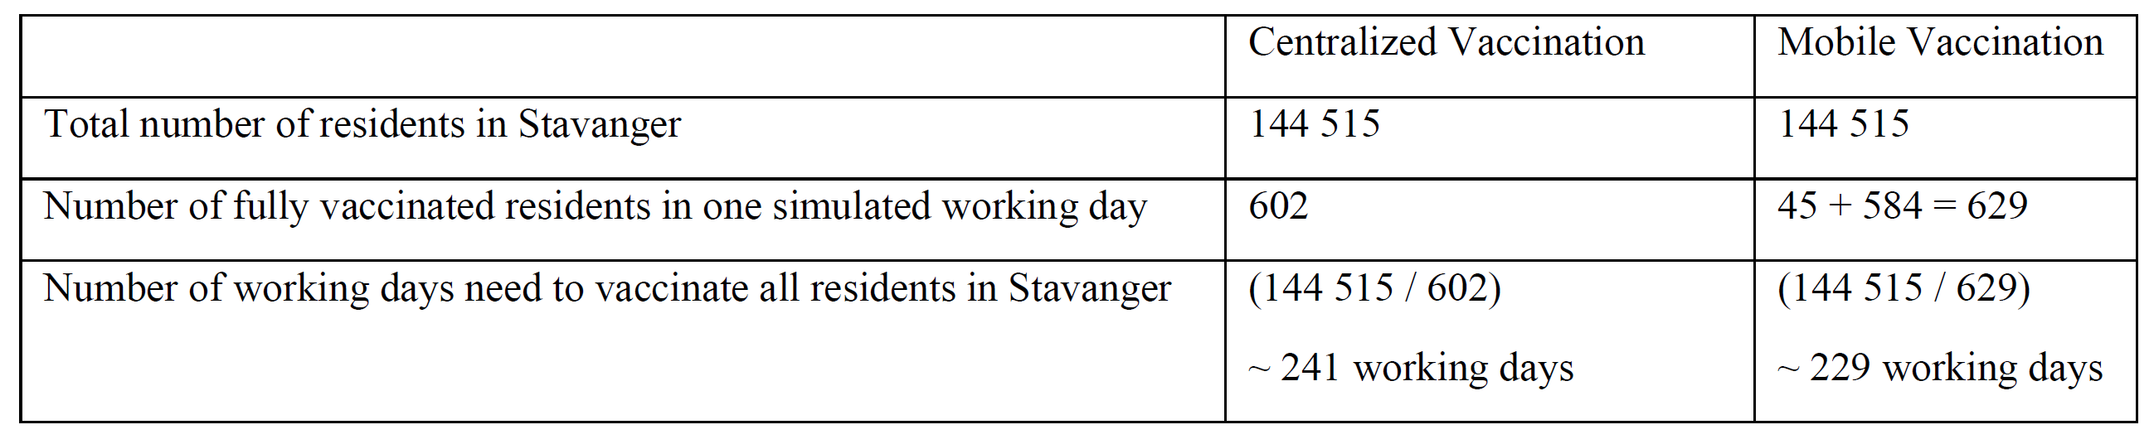
Centralized vs. Mobile Vaccination – Upscaling
To find out:
  How much time does it take to vaccinate the 144515 residents of Stavanger per 2021 under both vaccination programs?
  Which vaccination program is the most efficient in terms of time and speed?
Scaling up by performing simple math using key figures about the simulation environment and its results.
Mobile vaccination able to fully vaccinate 144515 people in ~ 241 days.
Centralized vaccination able to fully vaccinate 144515 people in ~ 229 days.

Slide 16
References & Related Work
[1] Statista, Fatality rate of major virus outbreaks worldwide in the last 50 years as of 2020, 2021. Available: https://www.statista.com/statistics/1095129/worldwide-fatality-rate-of-major-virus-outbreaks-in-the-last-50-years/. Accessed on: 06.10.2021.
[2] The College of Physicians of Philadelphia, History of Vaccines, an educational resource by the college of physicians of Philadelphia, 2021. Available: https://www.historyofvaccines.org/timeline/all. Accessed on: 06.10.2021.
[3] James Lyle Peterson. 1981. Petri Net Theory and the Modeling of Systems. Prentice Hall PTR, USA. page 7.
[4] Smith IM, Smith DTL. Mass production methods for mass vaccination: improving flow and operational performance in a COVID-19 mass vaccination centre using Lean. BMJ Open Quality 2021;10:e001525. doi:10.1136/ bmjoq-2021-001525. Available at https://bmjopenquality.bmj.com/content/bmjqir/10/3/e001525.full.pdf. Accessed on: 20.10.2021
[5] Stanley A. Plotkin, Mass Vaccination: Global Aspects - Progress and Obstacles, 3rd ed. Berlin Heidelberg: Springer, 12. feb. 2010. Available at https://books.google.no/books?id=Z1K73a84c6YC&lpg=PP1&hl=no&pg=PP8#v=onepage&q&f=false. Accessed on: 23.10.2021
[6] Reggie Davidrajuh, Modeling Discrete-Event Systems with GPenSIM An Introduction, 1st ed. Cham: Imprint Springer; Springer International Publishing, 2018. Available at https://link.springer.com/content/pdf/10.1007%2F978-3-319-73102-5.pdf. Accessed on: 23.10.2021
[7] Statistics Norway, 2021. Available: https://www.ssb.no/kommunefakta/stavanger. Accessed on: 22.11.2021.
[8] The Municipality of Stavanger, Online Open Data, 2021. Available: https://open.stavanger.kommune.no/dataset/gatenavn-stavanger. Accessed on: 22.11.2021.

Slide 17
Thank you
Any questions or suggestions for improvements ☺

